Slide 1
The PID Controller

Slide 2
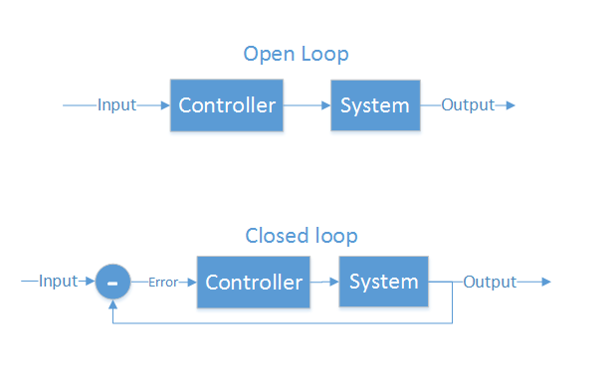
Control Theory
Making a physical system do what you want
“Open loop” and “closed loop”
Open loop - cannot see the system’s output
Motor controllers
LCD/LED/CRT screens
Some ICBMs
Closed loop - Can see output, make corrections
Autopilot
GPS guided munitions
Our quadcopter

Slide 3
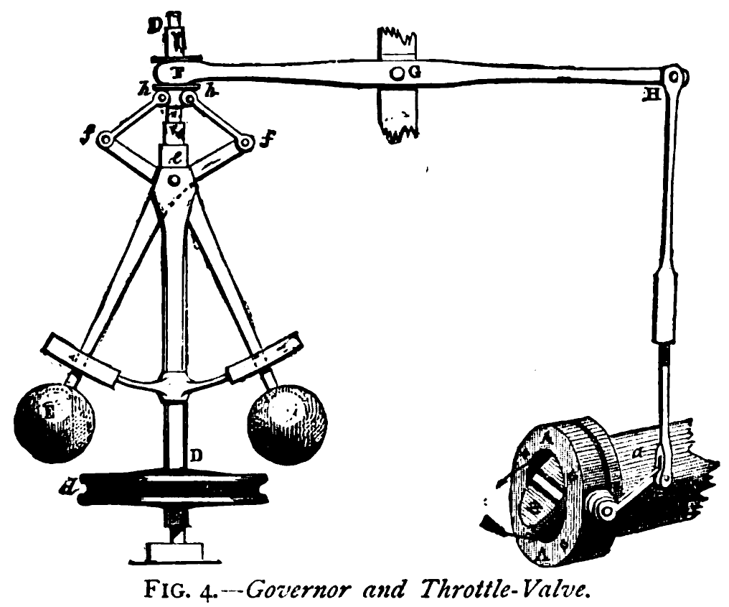
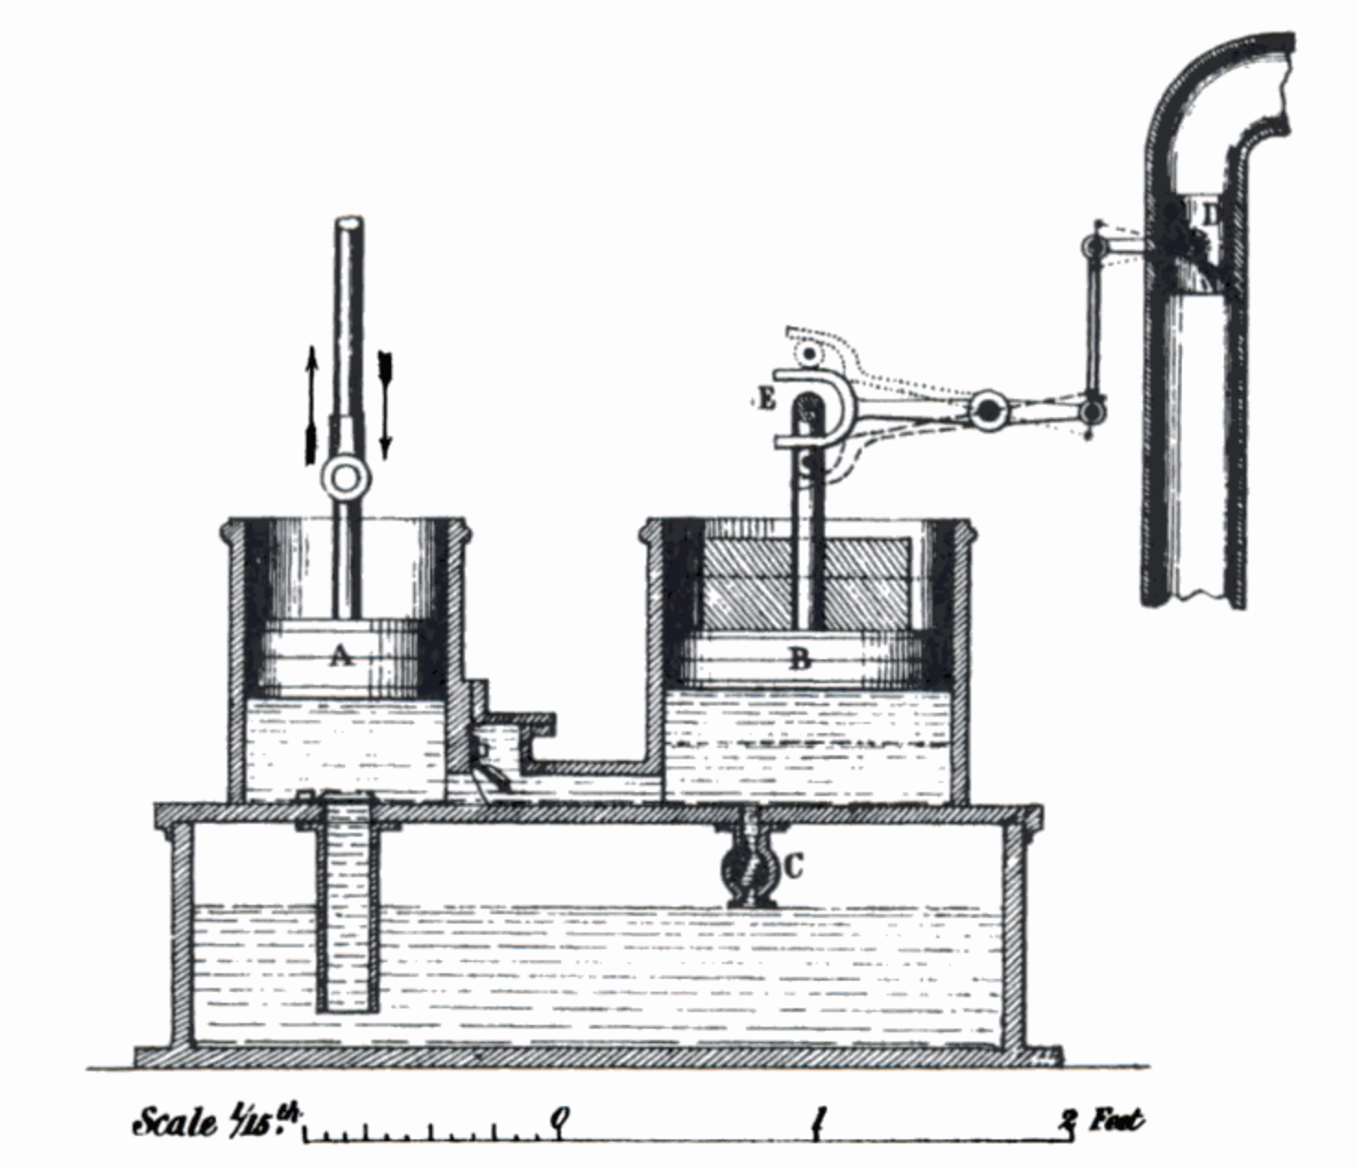
What is PID?
Make a system follow a set point
“Proportional, Integral, Derivative”
A brief history:
1788 - James Watt’s flyball governor (P)
1837 - Louis Molinié hydraulic regulator (PI)
1857 - H.N. Throop marine engine governor (PD)
1868 - Maxwell gives theoretical basis
1911 - Elmer Sperry, ship steering (PID)

Slide 4
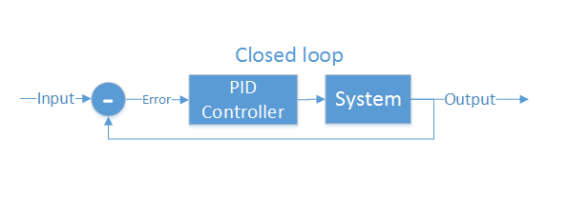
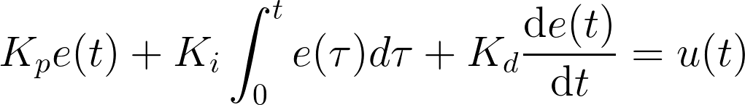
Closed loop control
PID is the most common closed loop controller
Proportional: Directly against error
Integral: Remembers error over time
Derivative: Dampens response to avoid oscillations

Slide 5
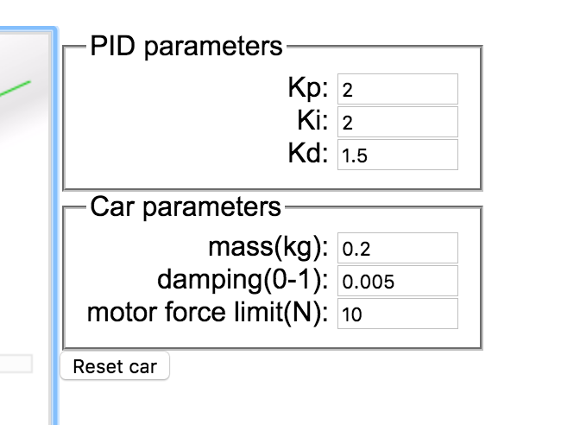
Example
https://sites.google.com/site/fpgaandco/pid

Slide 6
PID on the Quadcopter
3 separate controllers
PID set point is from user

Slide 7
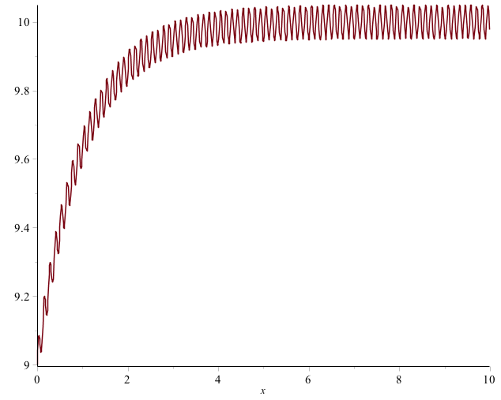
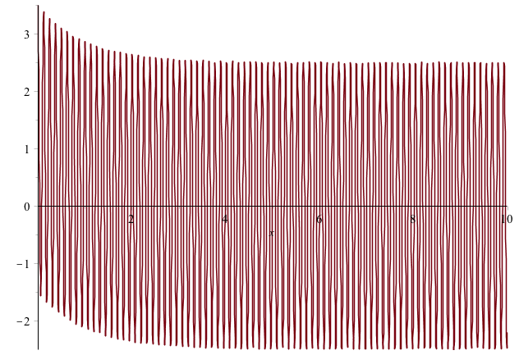

Pitfalls of PID
Integral term “Windup”
One solution: Exponential decay on integral (E.g., I = I/2 + error)
Derivative noise: beware of vibrations
Error term with vibration
Derivative term causes your system to go insane
Solution: moving average of last several values. Or median of last several values.
Using the serial plotter in arduino to watch the D term.
3. Tweaking PID values
Tune P first, then D, then I.

